Slide 1


Slide 1
HuskyJobs
Northeastern’s Internal Job Portal

Slide 2

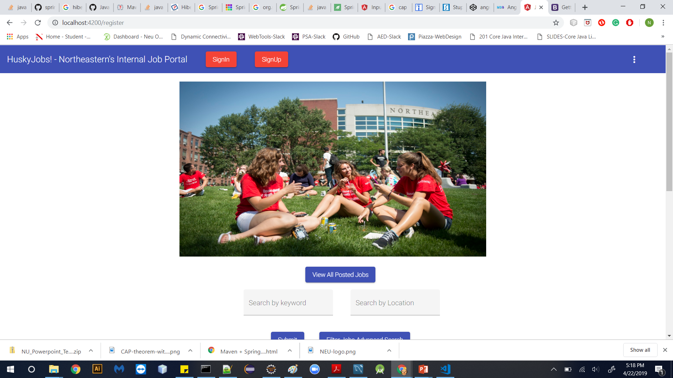
Simple Online Job Portal designed to help Northeastern Students find all types of jobs

Slide 3

CONTENTS
Project Statement
Functional and Non-functional Requirements
Technologies and why I chose them?
Features
Screen Shots
Future Scope

Slide 4

PROBLEM STATEMENT
HuskyJobs! – an internal job portal for Northeastern University is an application that will allow students to search for jobs online. This is a simple application that will allow Job Posters to post new jobs and Job seekers to apply for new jobs.
The job seeker can register/login into the application where all the recent jobs will be displayed. Job seeker can also search jobs via multiple filters like keywords and location of jobs. Job seeker can apply for jobs.
The job poster can register/login into the application. A Job poster can view all applicants that applied for the job that was posted. A job poster can post new jobs.

Slide 5

FUNCTIONAL REQUIREMENTS
Search jobs (by keywords, locations)
Register a User
Login
User type - Applicant and Job Poster
Applicant use cases -
Find jobs
View all jobs
Apply for a job
Upload resume
Check Application Dashboard
6. Job Poster use cases -
Post a job
Dashboard
Delete a job

Slide 6
NON-FUNCTIONAL REQUIREMENTS
Backend should support microservice-paradigm
Frontend should be modular

Slide 7



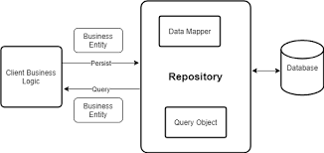
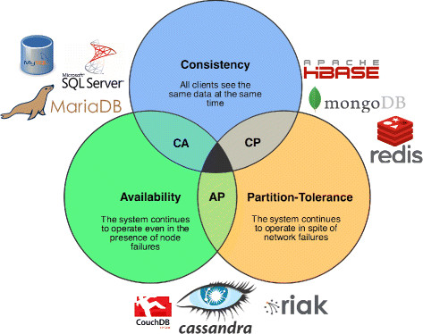


TECHNOLOGIES AND WHY I CHOSE THEM?
Front-End
Backend
Data Access
Database
Angular
IDE- Visual Studio Mix
Angular Material
Wireframe: used for making mock-up screens
Spring Boot
Spring MVC
Hibernate/JPA
Spring Security
Swagger
Repository using Hibernate
MySQL Workbench

Slide 8
Why I chose these Technologies?
Front-end
• Angular – allows to create custom modules and components and provides angular material for styling of web pages
• IDE – Visual Studio Code – provides front-end development kit
• Wireframes – used to design the application screens
b. Backend
• Spring Boot along with Spring MVC, hibernate – It is open source and widely used in industries
• Spring Security – Used for login/registration authentication and authorization
• Swagger – Used for testing API’s
c. Data Access
• Repositories and Services are used to make the application more modular and easy to maintain
d. Database
• MySQL Workbench – helps to easily administer MySQL environments, it has easy to use facilities.

Slide 9
FEATURES
Login/Registration of the User
Logout
View All jobs
Filter Jobs by location and keywords
Delete a job
Apply for a job
Post a job
.

Slide 10
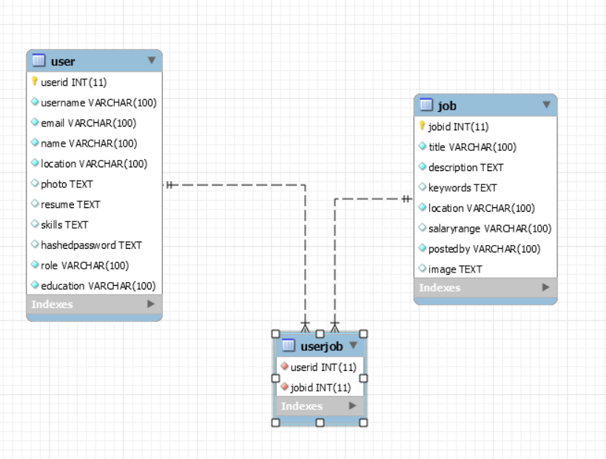

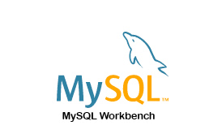
Slide 6
DATA MODEL - EER DIAGRAM

Slide 11
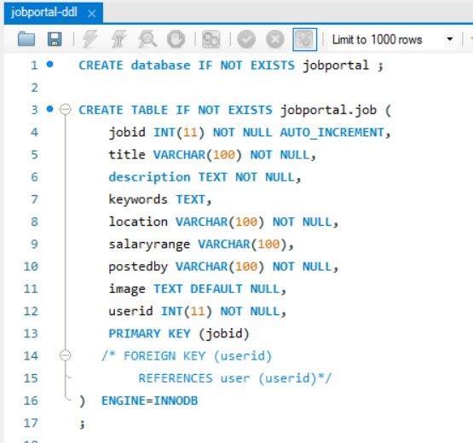
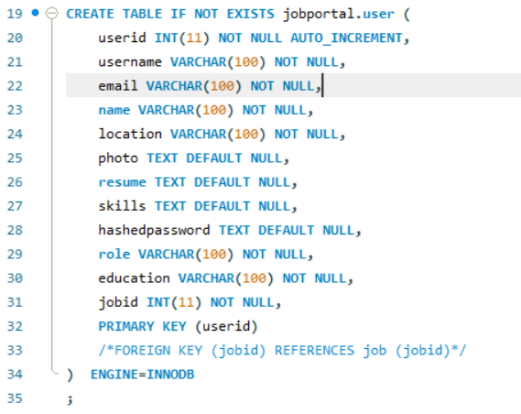
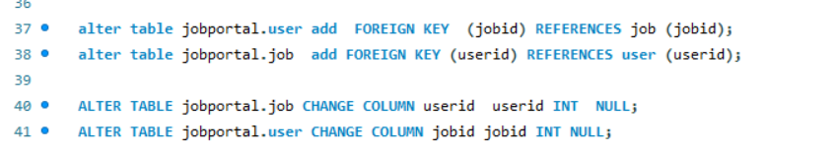
DDL Scripts

Slide 12
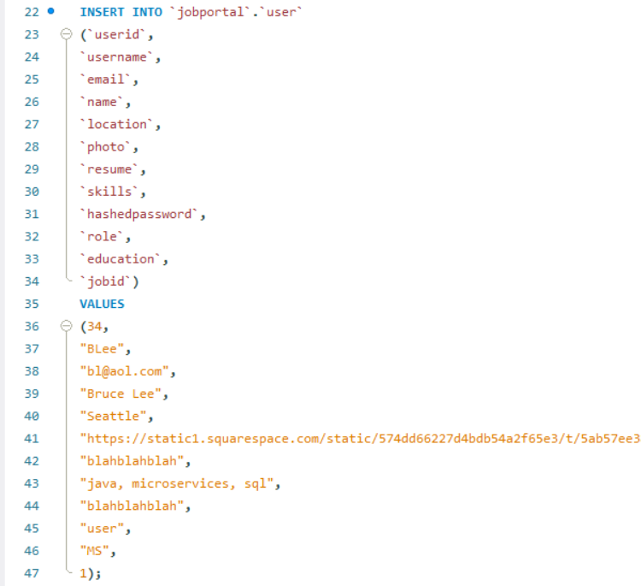
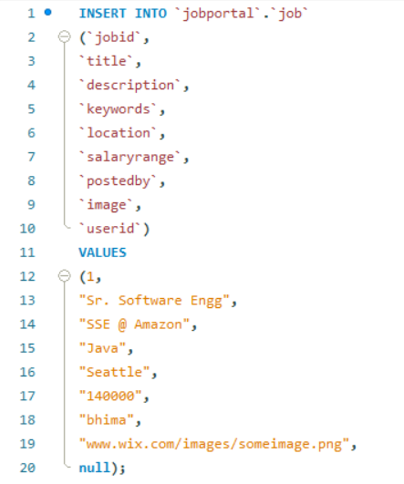
DML Scripts

Slide 13
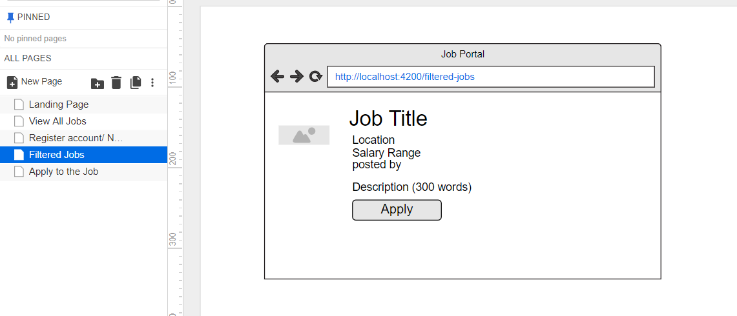
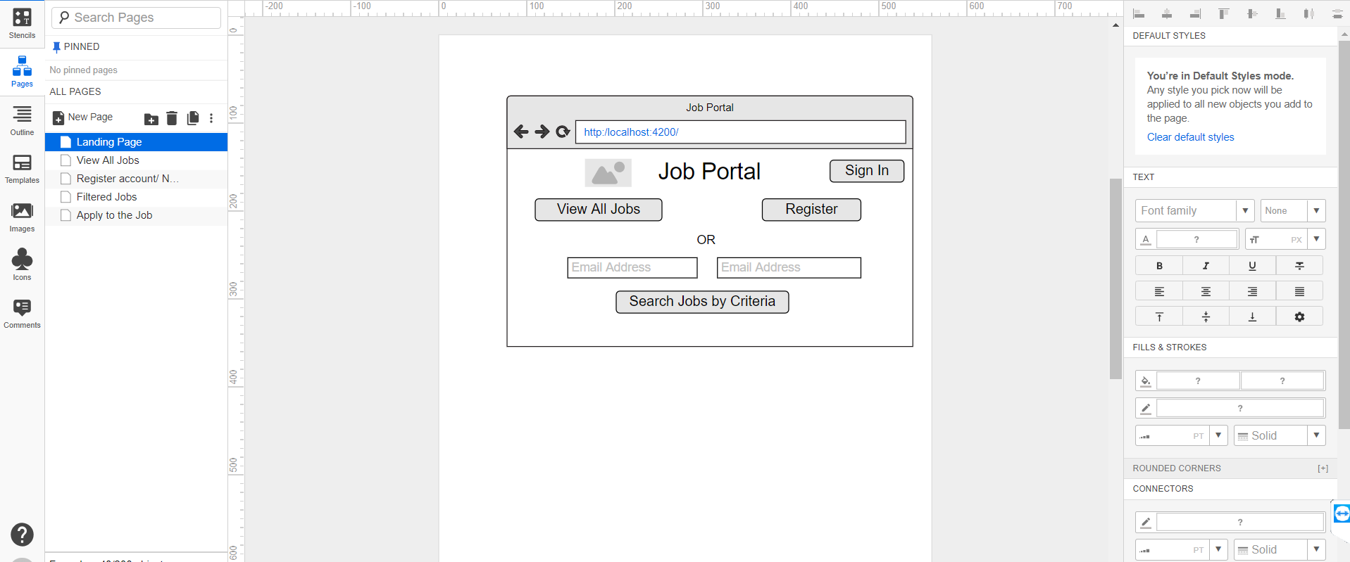
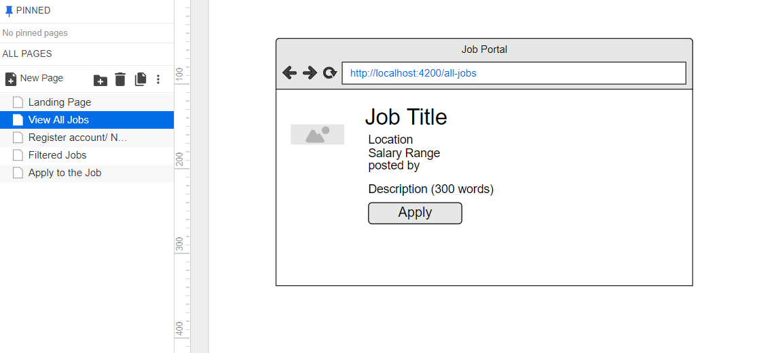
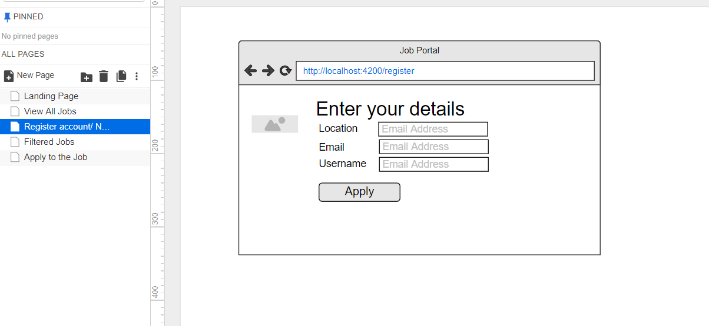
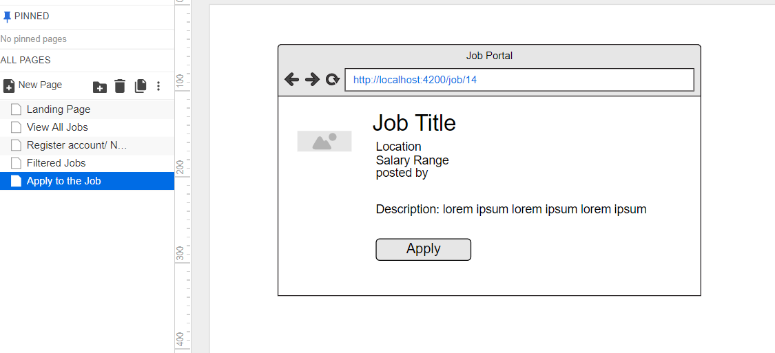
FrontEND: IMAGES OF WIREFRAMES

Slide 14
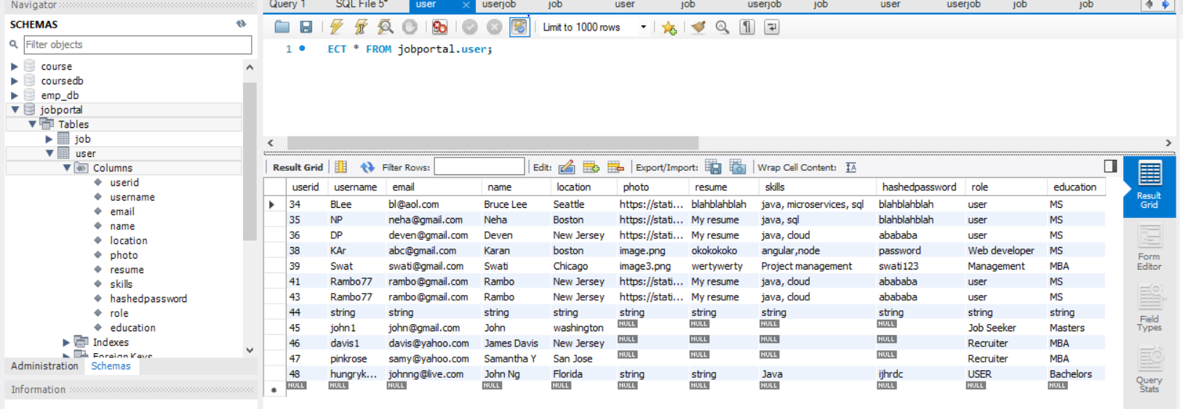
DATABASE OUTPUT IMAGES

Slide 15
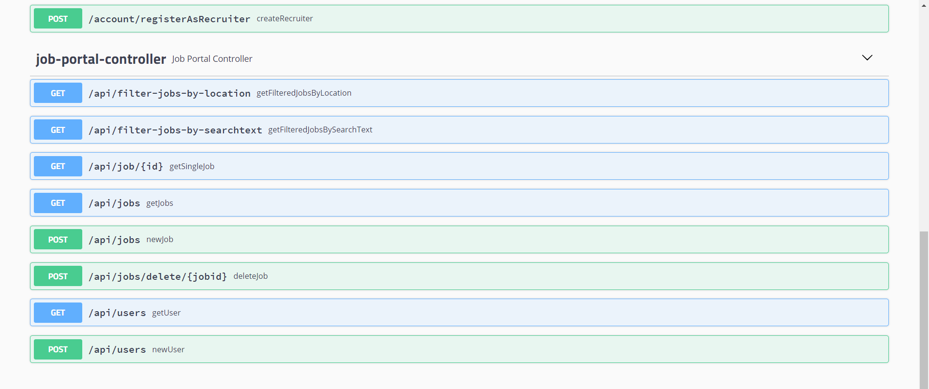
SWAGGER SCREEN

Slide 16
FrontEND: IMAGES OF WIREFRAMES

Slide 17
FrontEND: IMAGES OF WIREFRAMES

Slide 18

Future Scope
Authentication by an External Identity Provider
Eg: Northeastern Enterprise Authentication Service/ Central Authentication server (for inside NEU)
Login with Google, Facebook
Advanced reports can be pulled by Job Posters
Messaging between Users

Slide 19

REFERENCES
StackOverflow.com
Class Notes

Slide 20

Slide 10
THANK YOU

